Slide 1

Software development life cycle
By: Shanysse Alexander

Slide 2
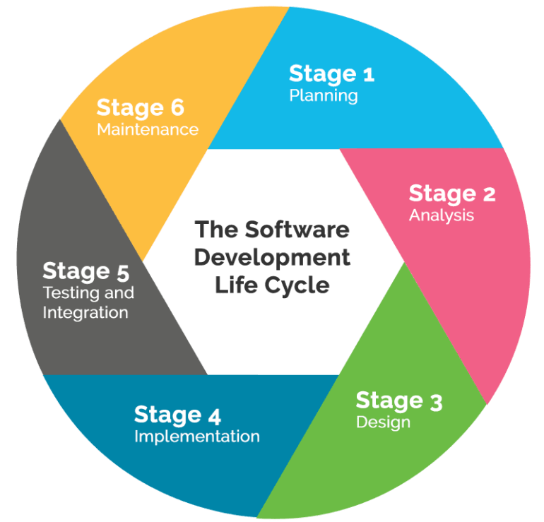
What is the software life cycle?
A commonly used system to develop high-quality software applications. At each phase specific task are to be completed in order to move on to the next phase.

Slide 3
Phase 1,2,& 3
1st Planning- Gather essential requirements from customers and then Business Analysts collect this data plan Business Requirement Specification or BRS for the product.
2nd Defining- Sections of the company such as Human Resources (HR) find out if it is feasible and possible within the budget. The costs, resources, and time determines if the product will move on to the next phase.
3rd Designing- This is the blueprint of the product and it specifies the hardware and equipment of your system.

Slide 4
Phase 4,5,&6
4th Building- The coding necessary for the product is written or preparation for a prototype is started.
5th Testing- Engineers conduct testing to check for bugs and run-time errors to check and see if the functionality of the product is working as per the requirement or not.
6th Deployment - Once the prototype or product is developed, tested and completed its installed or deployed in the customer’s workplace.

Slide 5

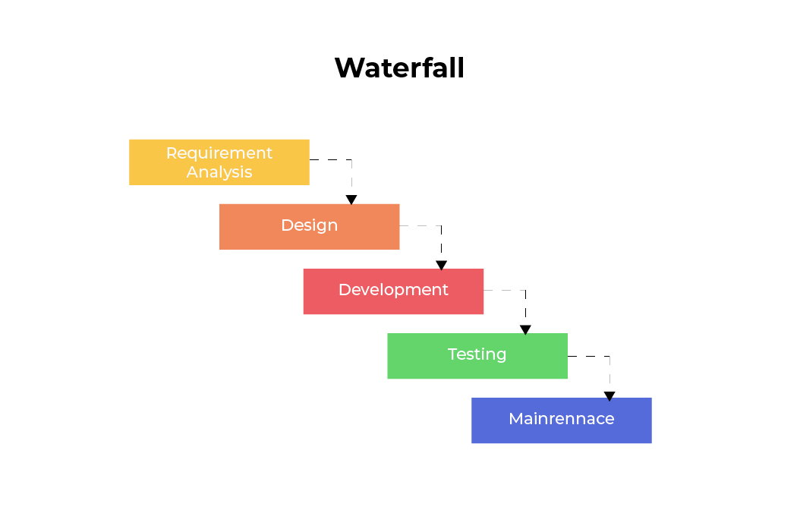
What is the waterfall model?
A model of software development that has a diagrammatic representation similar to a waterfall.

Slide 6
Waterfall model phases
Requirements Analysis & Specification- The customer and the software developer work together to understand the exact requirements of the customer. Here the Software Requirement or SRS document is created to give a detailed description of the system.
1
Design- Gives the overall software architecture with very detailed design shown in the Software Design Document (SDD).
2
Implementation & Unit Testing- Here the design is implemented and the code should run smoothly if the SDD is complete.
3
Integration & System Testing- This phase is crucial to the final success of the system. Here the modules are tested for how they interact with each other and with the system.
4
Operation & Maintenance- Maintenance is performed by the user once the software has been delivered to the customer, installed, and operational.
5

Slide 7
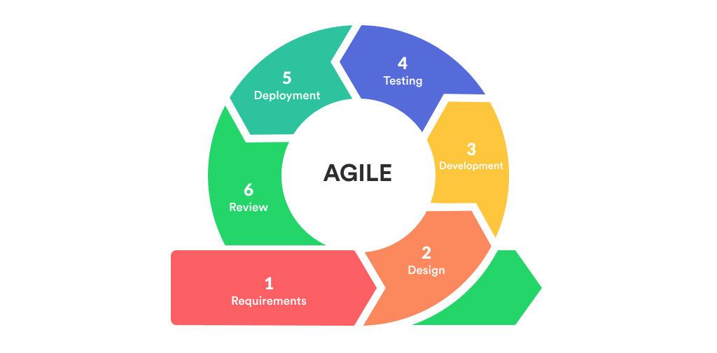
What is the agile model
The Agile Model breaks down a product into small parts to build up to the final product. This model emphasizes process adaptability and customer satisfaction by rapidly delivering a working software product.

Slide 8
Waterfall v.s agile model
Waterfall
Linear sequential
Structured
Fast delivery of the product
Works well with smaller projects
Agile
Continuous increments of developing and testing
Flexible
Focuses more on the client
Works well with bigger projects

Slide 9
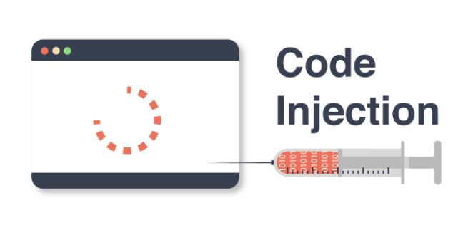
Security injections
Injections are attacks on web applications. These attacks are the major threat against security for web applications.
Security injections test a program for these types of attacks.

Slide 10
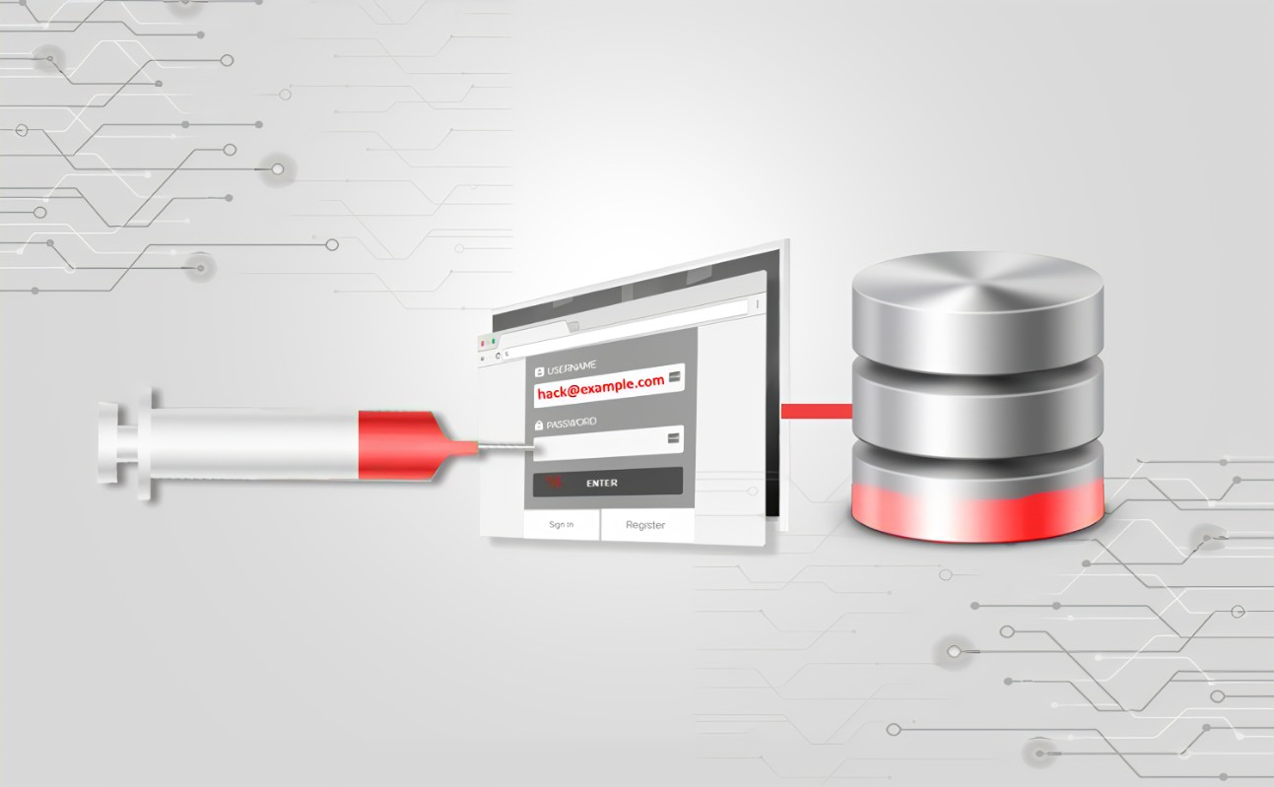
Security injections in the software life cycle
Security injections would be in the testing portion of the Software Life Cycle.

Slide 11
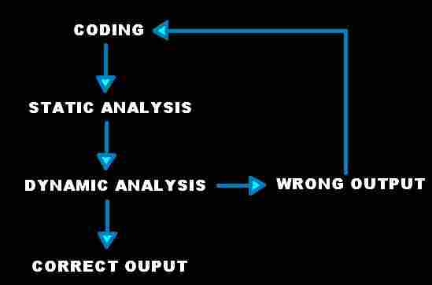
Static & Dynamic Software analysis
Static
Test and evaluates an application by examining the code without it being executed.
Examines all possible execution paths and variable values
Dynamic
Test and evaluates an application while the code is being ran.
Reveals vulnerabilities within the code

